Slide 1
SOCIAL MEDIA
Staying out of trouble (Part 1)
Daniel Hurford
Welsh Local Government Association

Slide 2
SOCIAL MEDIA
Staying…in touch

Slide 3
Overview
Part 1: Staying in touch
What is Social Media?
Why should you use it?
What types of Social Media are out there?
How to use it?
Part 2: Staying out of trouble
Legal Issues
Code of Conduct
Reputation

Slide 4
What is social media?
Social media broadly means online multimedia/apps which allow you to create and publish content and engage in two-way communication.
Social media can be accessed via apps on your smartphone, computer, tablet, smart TV or smart watch.
Social media accounts tend to be free can be set up quickly and easily

Slide 5
What is social media?
It’s just a new(ish) form of communication
Humans have communicated and shared information through graphic, oral or written media for millennia…
…why should we be afraid of or dismissive of this relatively new media?
It’s free, available and open to all – information and mass-communication from the palm of your hand!

Slide 6
It’s popular!
Facebook:
Around 30 million users in UK.
Facebook is the default social networking site for 96% of UK adults who are online (Ofcom)
Twitter:
Twitter says 15m UK users (end of 2013)
ONS suggests around 9.5m
Stats from http://www.rosemcgrory.co.uk/
Newspapers:
8m national newspaper circulation

Slide 7
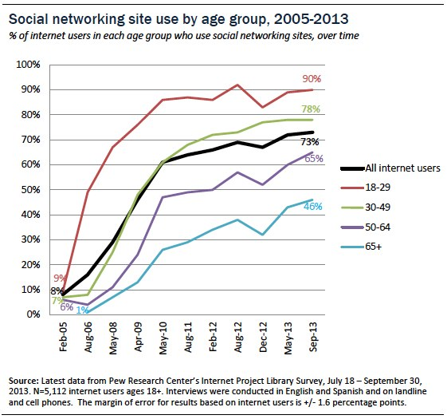
It’s growing!

Slide 8
It’s here to stay…or is it?
Who still paints caves?
Who still relies on town criers for the latest gossip from Albert Square?
Who still sends a postcard wishing your Great Aunt Mable was with you clubbing in Ayia Napa?
Who still buys a daily newspaper?
Who remembers ‘Friends Reunited’?

Slide 9
What is Social Media?
…online multimedia/apps allowing you to create and publish content and engage in two-way communication.

Slide 10
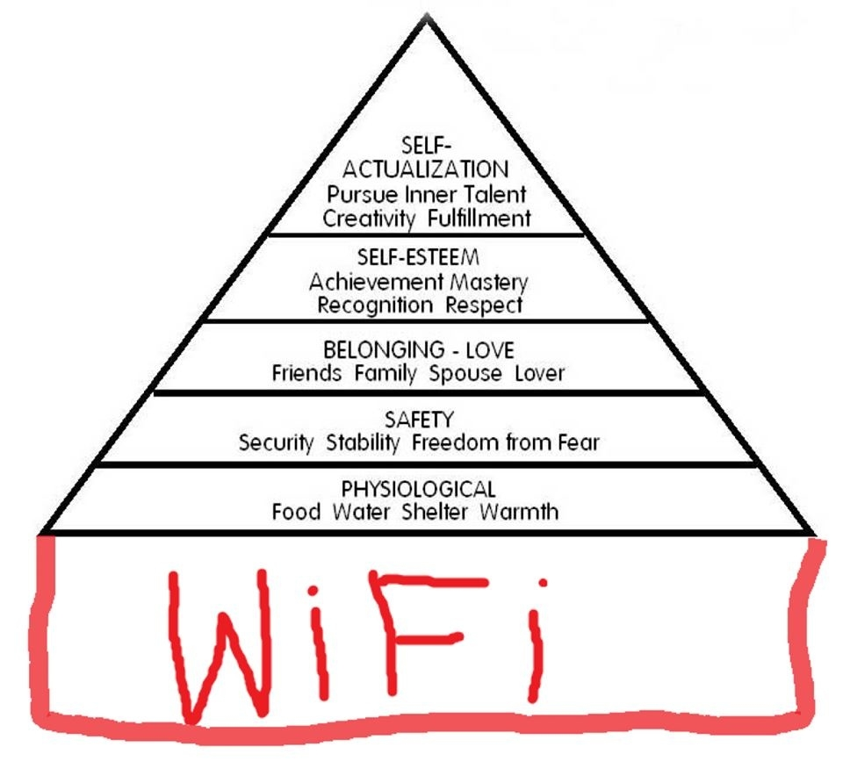
Increasingly part of everyday life

Slide 11
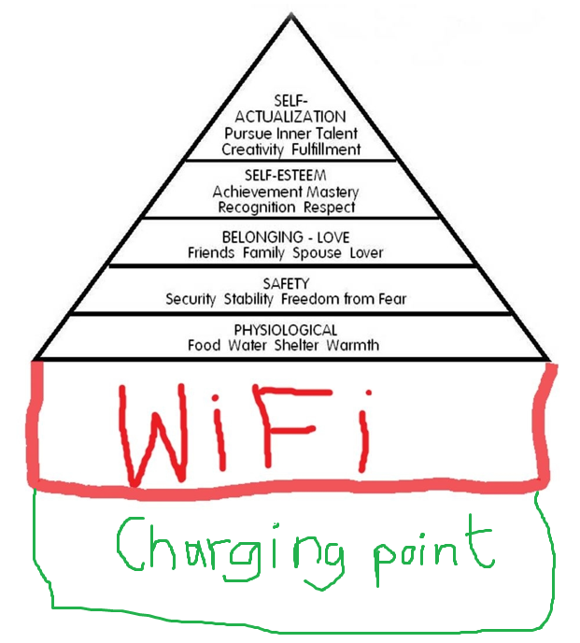
Increasingly part of everyday life

Slide 12
What is Social Media?
“LinkedIn is for the people you know. Facebook is for the people you used to know. Twitter is for people you want to know” Unknown

Slide 13
Blogging
Arguably, where social media started.
Basically, a personal website which is easy to update and migt typically include:
Diary or journal
Occasional Thoughts
Articles or thinkpieces – often to prompt debate and exchange of views.
Photos or media.

Slide 14
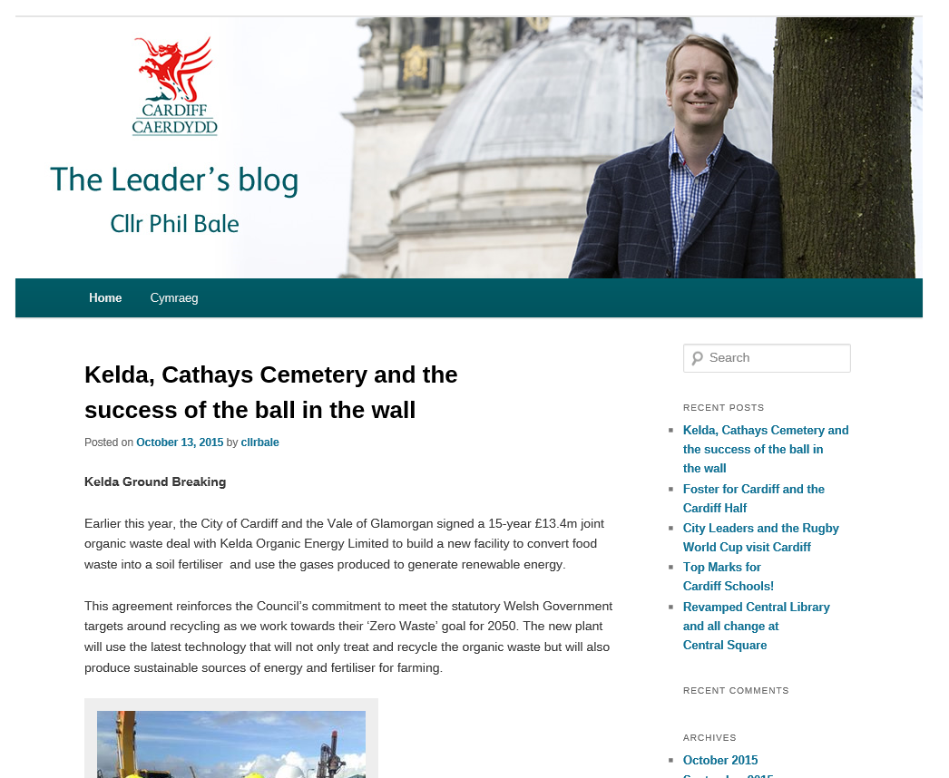
Some live examples
https://cardiffleadersblog.wordpress.com/

Slide 15
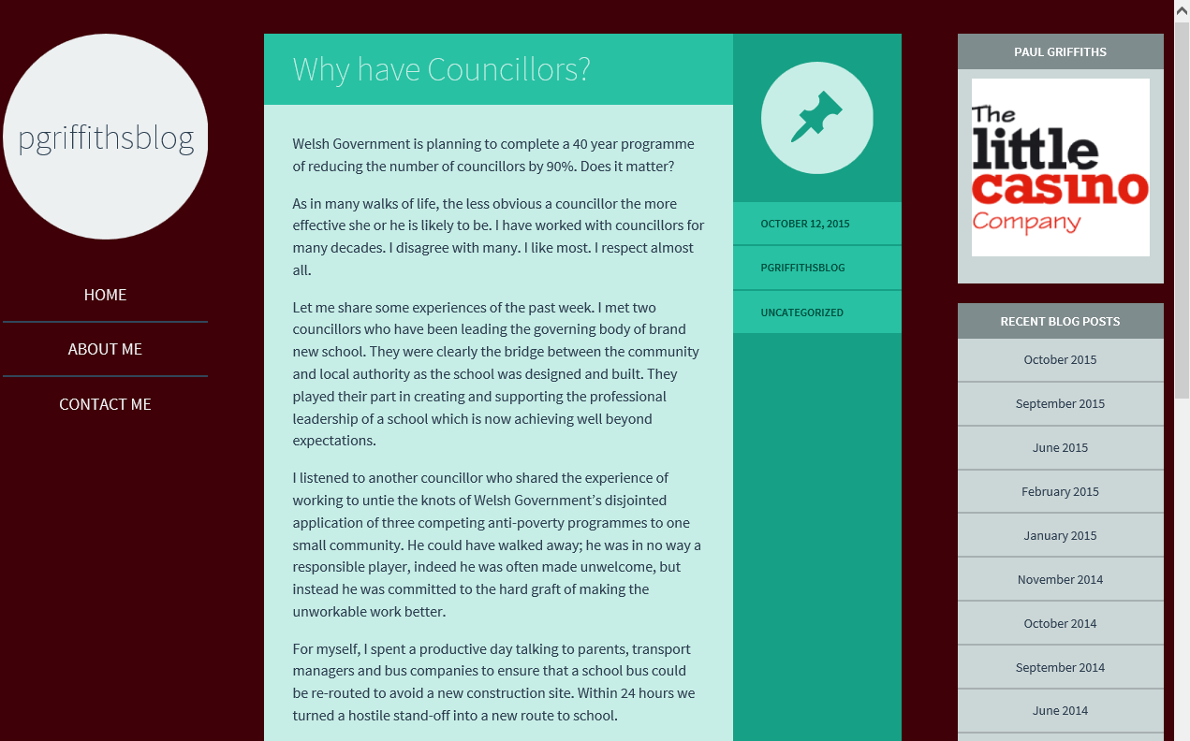
Some live examples
https://pgriffithsblog.wordpress.com/

Slide 16
Facebook
Most popular social media platform in the world.
1 billion users worldwide and around 30 million users in UK
Public or Private forum to:
Blog
Post messages to friends and family
Share photos
Share things of interest, concern or humour
Your contacts or “friends” can comment on your posts, share them with their “friends” or “like/dislike” things.

Slide 17
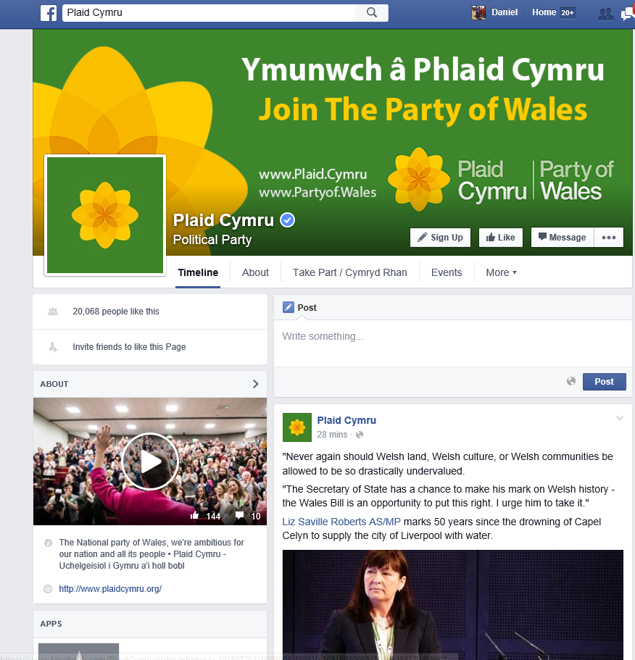
Some live examples

Slide 18
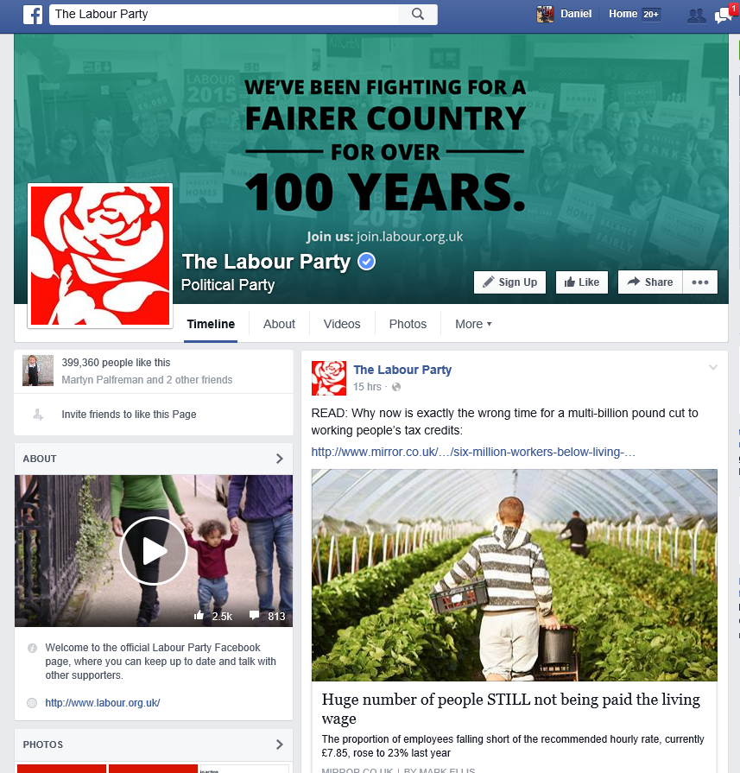
Some live examples

Slide 19
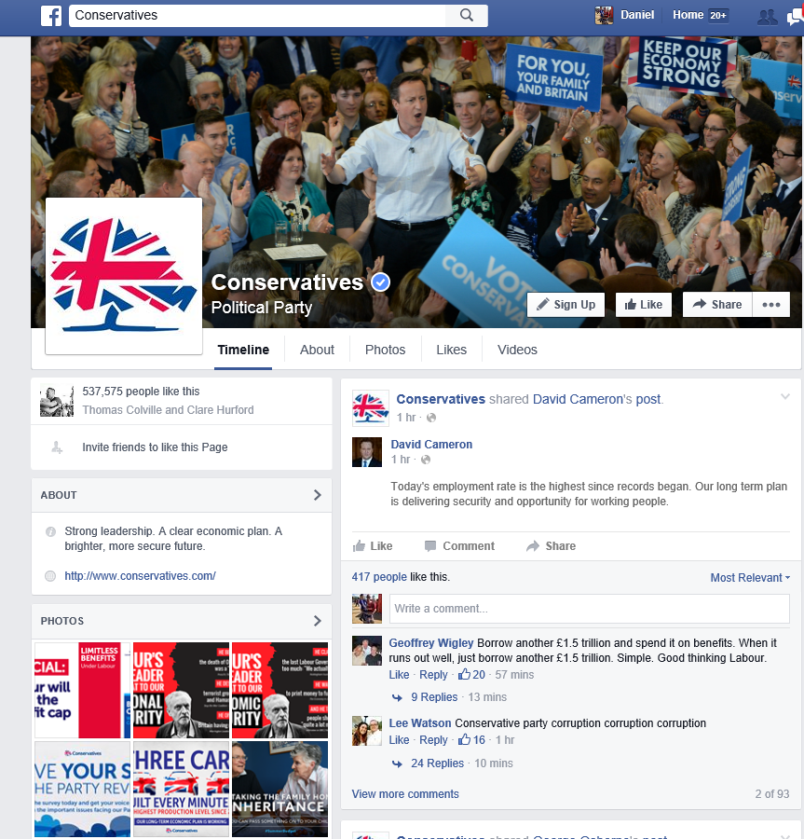
Some live examples

Slide 20
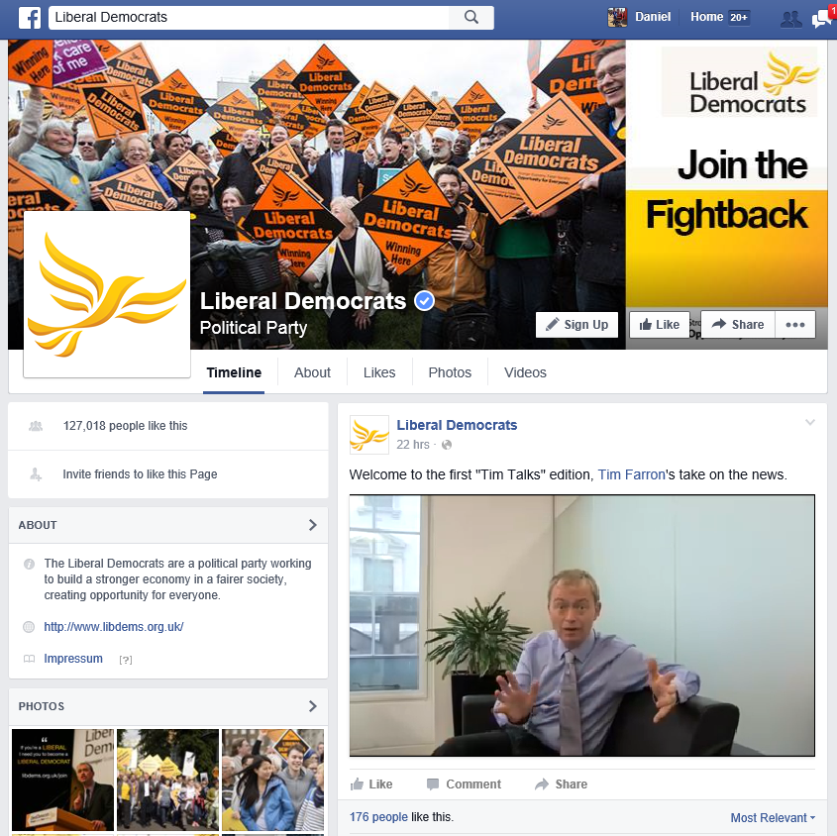
Some live examples

Slide 21
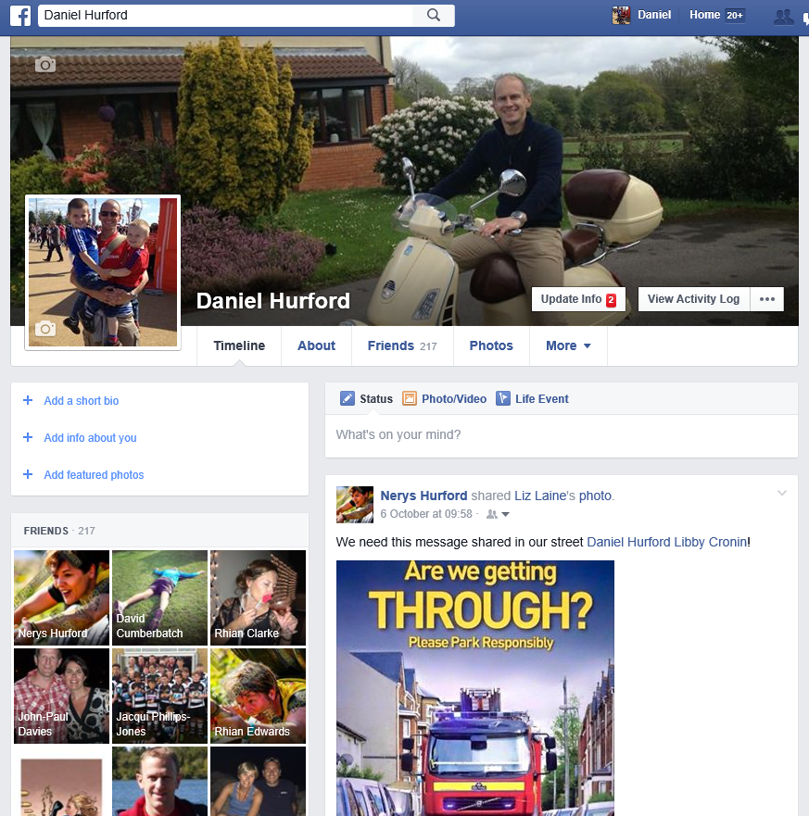
Some live examples

Slide 22
Why use Facebook?
Very easy to set up
You can have public or private groups (or pages) – you can act as an administrator or editor, so you can approve who joins your group and can remove inappropriate postings (if necessary)
Can be used as a community mini-website

Slide 23
Why use Facebook?
Useful for seeking views, engaging with people and promoting events etc.
Easy to promote and share and get more ‘friends’, exposure and engagement
Watch-out for:
Hearing things that may be challenging – it’s all about engagement afterall. These ‘negative’ comments will be seen by all.
Inappropriate comments and postings
It taking over your life!!!

Slide 24
Twitter
Lot of users – between 9.5m and 15m in UK
Each post is called a tweet
Brevity is key - maximum of 140 characters per tweet (including all spaces, letters and numbers)
You can add pictures and videos or links to websites etc.
You can ‘favourite’ a tweet or ‘retweet’ a tweet

Slide 25
Twitter
You can ‘DM’ (Direct Message) someone – i.e. a private message like a text or email
You can ‘follow’ and have ‘followers’
“On Twitter we get excited if someone follows us. In real life we get really scared and run away.” Unknown via @mozusa

Slide 26
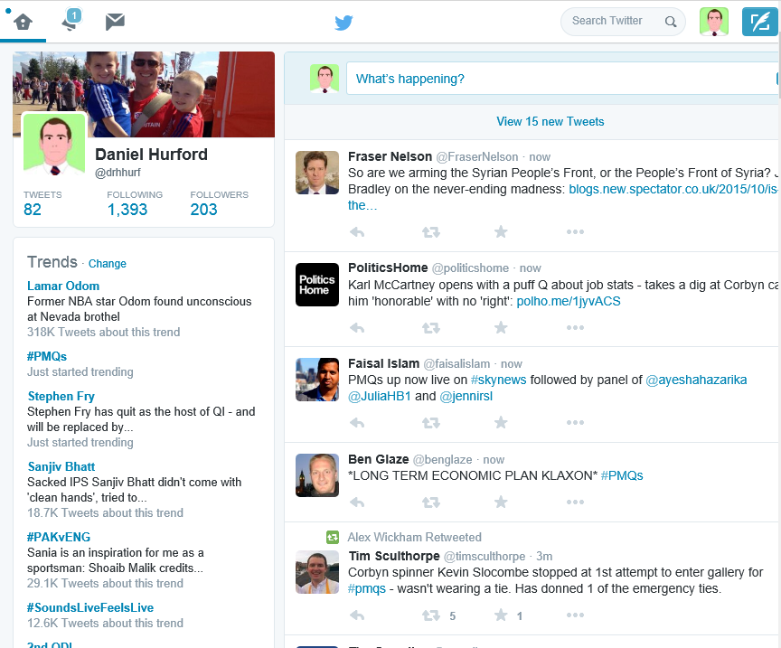
Some Live Examples

Slide 27
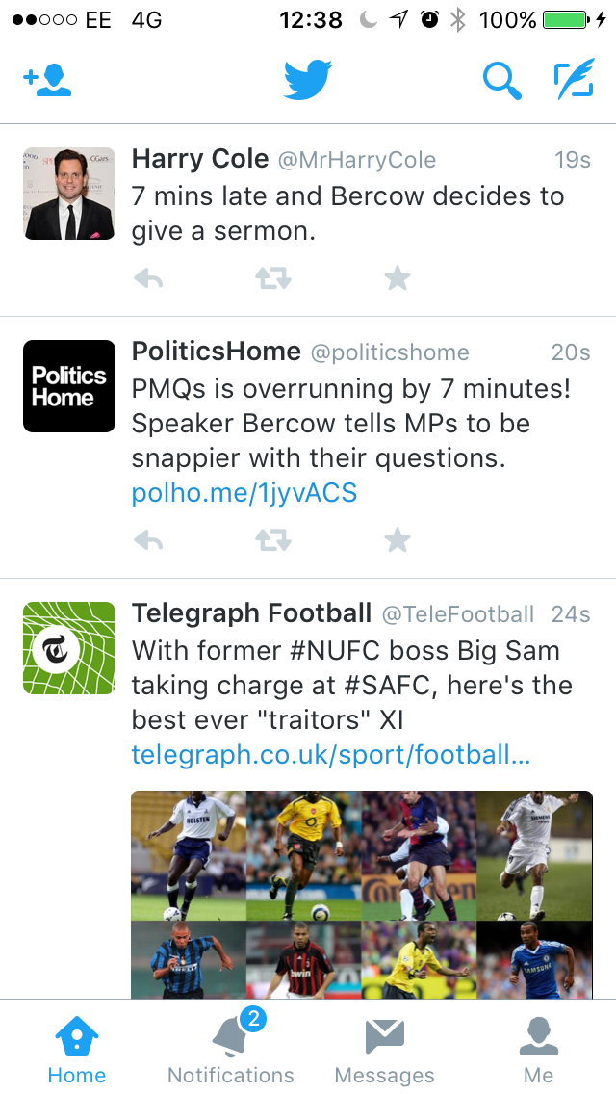
Some Live Examples

Slide 28
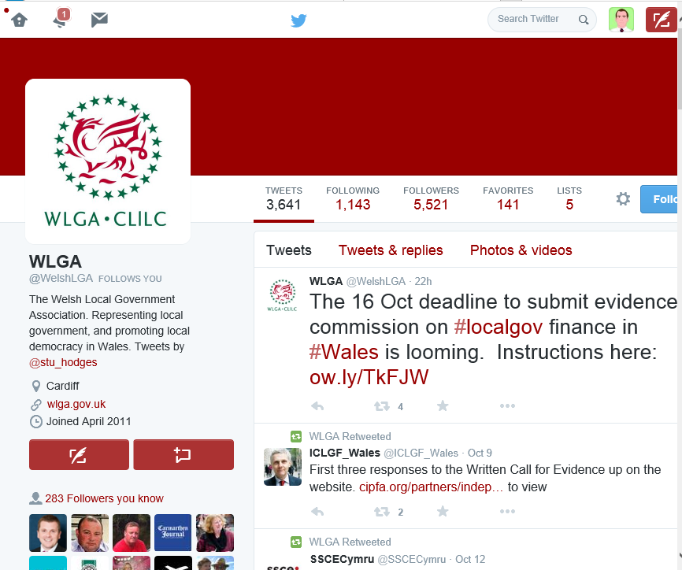
Some Live Examples

Slide 29
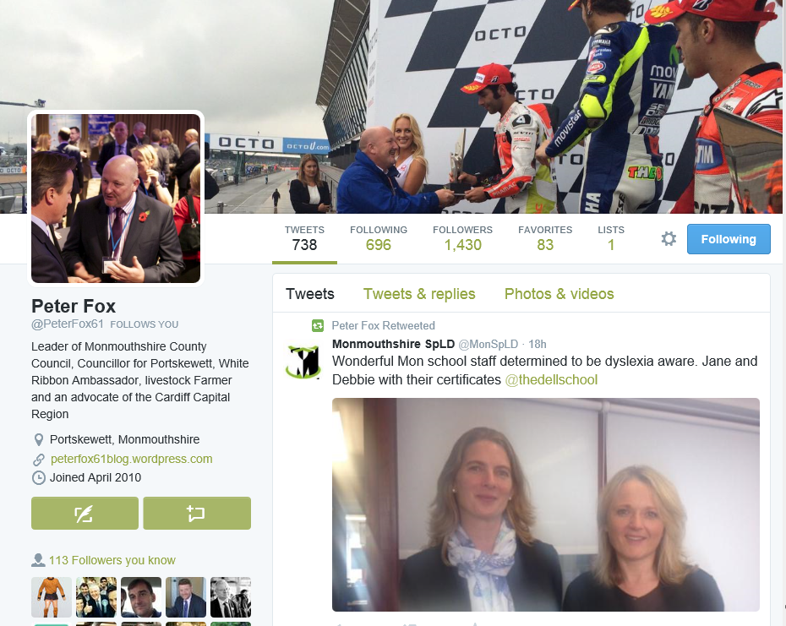
Some Live Examples

Slide 30
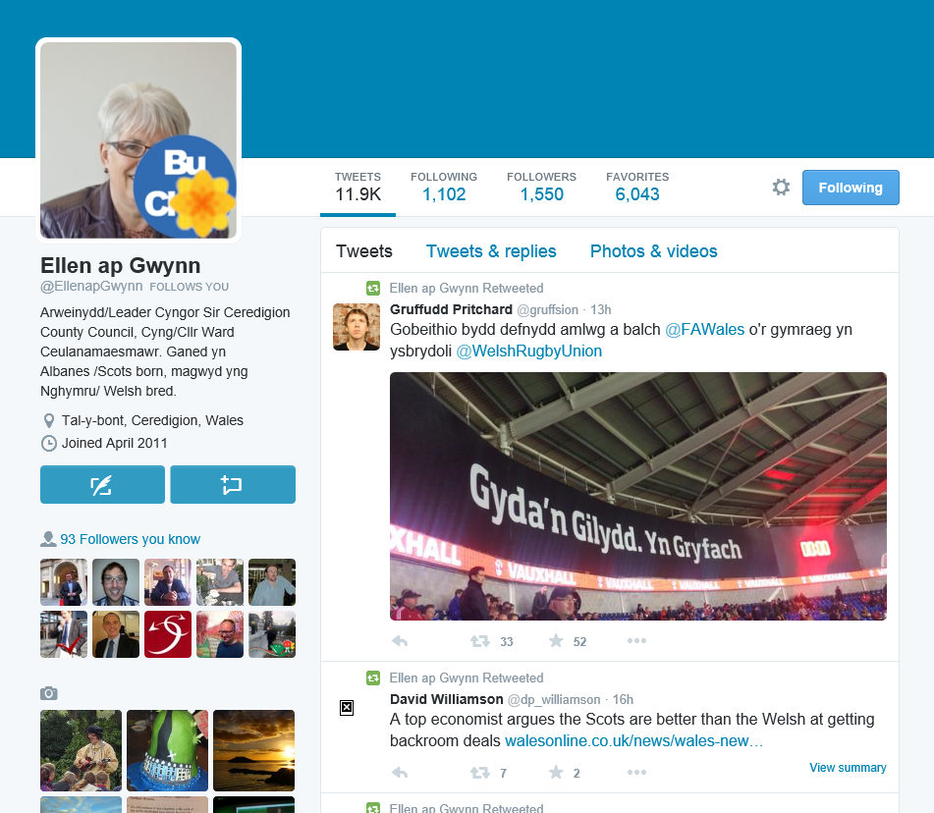
Some Live Examples

Slide 31
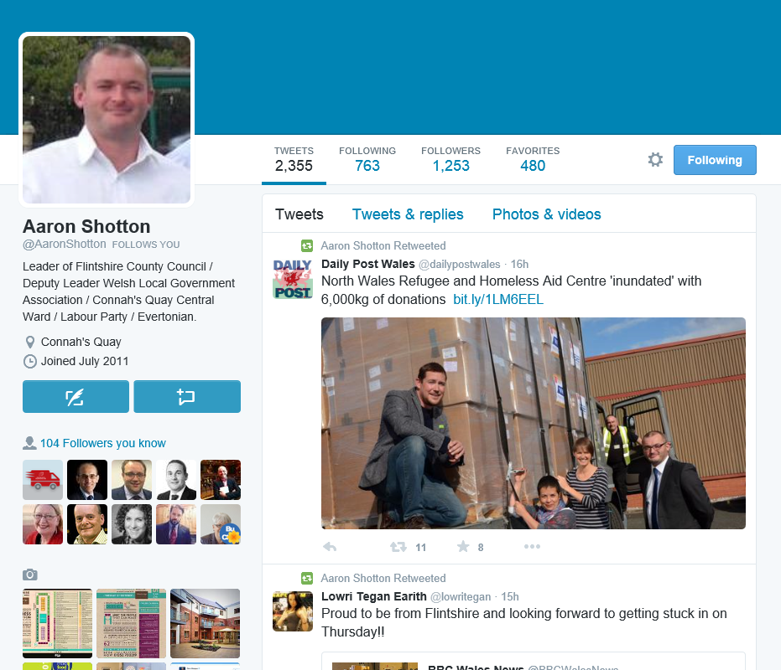
Some Live Examples

Slide 32
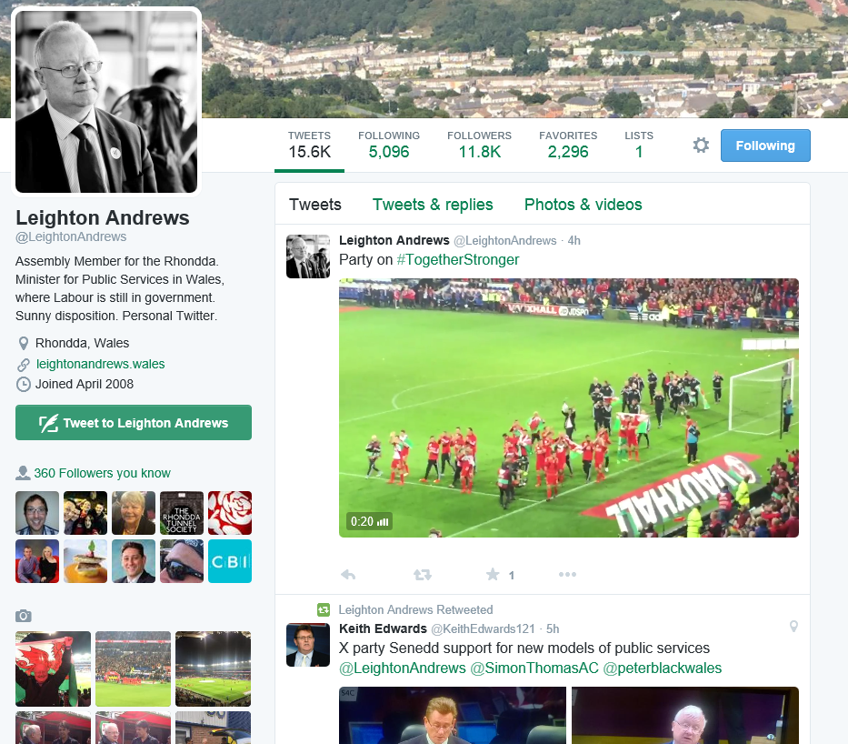
Some Live Examples

Slide 33
Why use Twitter?
Probably the easiest and most accessible social media to use
Instantaneously communicate with your followers, and potentially within seconds millions of others!
Share news stories or events from others
Find out what other people are saying (maybe about you or things you care about – sophisticated searches and alerts)

Slide 34
Why use Twitter?
Find out about intelligence or breaking news as it happens (careful here though…). Then share it and pass it on.
Can be very, very funny!
Can help make you appear human and normal!

Slide 35
Why use Twitter?
What to watch out for:
‘Trolls’ and abuse
Getting drawn into protracted public arguments
Tweeting when a text might be better
Tweeting when you’re ‘tired and emotional’

Slide 36
Why use Twitter?
What to watch out for:
Don’t believe everything you read on twitter…
Some of it is gossip and rumour
Some of it is deliberately untrue
There are some spoof accounts – people are not always who they purport to be
‘Clickbait’

Slide 37
Why use Twitter?
What to watch out for:
Retweeting some things…’retweets do not necessarily mean endorsements’ doesn’t stand up in court
The ‘twitterati bubble’ – twitter users are not necessarily a representative sample of society
A tweet is permanent, even if you think you’ve deleted it…so think before you tweet something contentious

Slide 38
So, to recap:
Social media is simple and free to use
Mass and quick communication
To make the most of it, don’t just tell people what you’re doing, listen to feedback too
People can find out about the real you
It can be fun!
It’s all going on already – you might be missing out

Slide 39
Tweet within twenty seconds…
Go to twitter.com
Sign-up (for free, no strings attached).
Choose your twitter username (@somebody) and a password.
Create your ‘profile’, with as much or as little detail as you’d like and maybe a picture or two.
Tweet and retweet
And remember to follow too, that’s how you find out what people are doing or saying and how you get followers back…

Slide 40
Any Questions?

