Slide 1
Are the Nolan Principles fit for purpose now & in 20 years?
NICK BENNETT
Public Services Ombudsman for Wales

Slide 2
Context
Ageing Population
Public spending unlikely to return to 2011 levels until 2025?
NHS/Social Services Integration
Green Paper ‘Our Health: Our Health Service’
Local Government Reform?

Slide 3
The Future
Constitutional issues
Size of the state and level of state provision of public services
Immigration
Innovation?

Slide 4
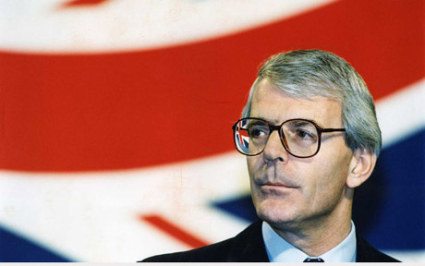
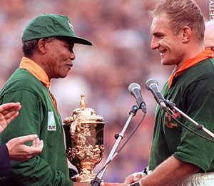
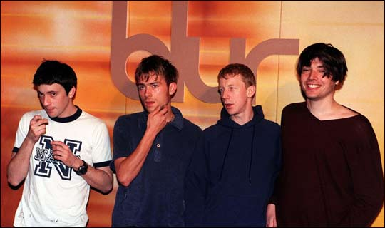
Looking back 20 years ...

Slide 5
Back to School ... 1985 ...

Slide 6
... 2015
“Every man’s island...every man’s watchman, is his conscience. There is no such thing as a collective conscious.”

Slide 7
Groucho Marx said ...
“Those are my principles and if you don’t like them ... well, I have some more.”

Slide 8
Dwight D Eisenhower said ...
“A people that values its privileges above its principles, soon loses both.”

Slide 9
The Nolan Principles
Selflessness
Integrity
Objectivity
Accountability
Openness
Honesty
Leadership

Slide 10
2014/15 – Code of Conduct Statistics
231 Code complaints received
35% - promotion of equality & respect
22% - disclosure & registration of interests
16% - integrity
10% - accountability & openness

Slide 11
2014/15 – Code of Conduct Statistics
Of the 231 Code complaints received
17 - identified a breach
8 - no action necessary
8 - referred to Standards Committees
1 - referred to Adjudication Panel for Wales

Slide 12
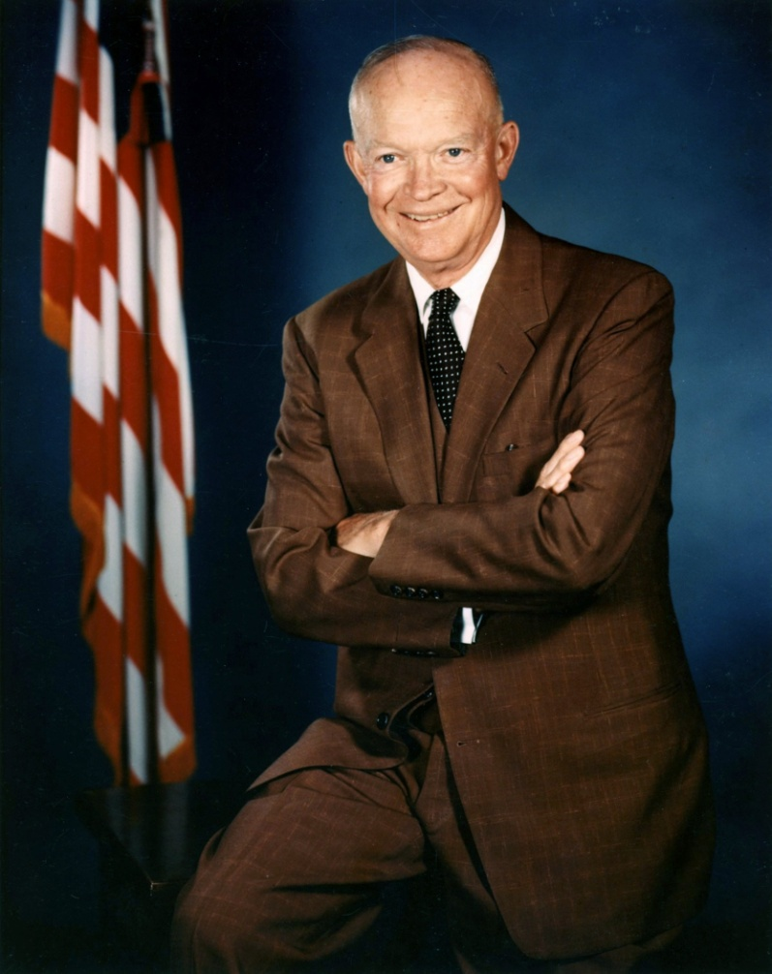
Leadership

Slide 13
Examples of vexatious Code complaints received by my office
“Cllr X refused to shake my hand!”
“Cllr Y cracked a bad joke in poor taste!”
“Cllr P tutted and huffed whilst shaking his head!”
“Cllr M referred to the public gathered in the street as a mob”
“Cllr S was clicking his pen on and off in an aggressive manner!”

Slide 14
Management Guru, Peter Drucker said ...
“Culture eats strategy for breakfast.”

Slide 15
A new PSOW Act to provide the Ombudsman with:
Own initiative investigation powers
The ability to accept complaints orally, or other communication methods, as well as in writing
The ability to consider complaints about private hospitals in certain circumstances
A complaints standards role

Slide 16
And Finally ...
Go set a watchman for Wales!
Diolch yn fawr!

